Slide 1

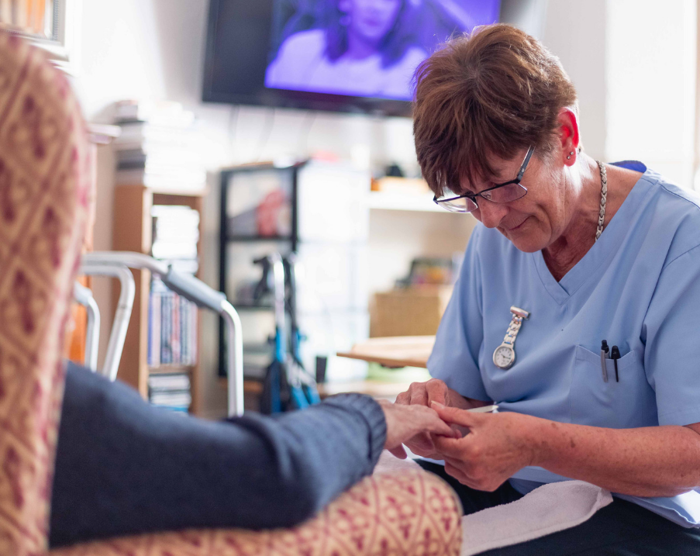

Southport & Formby Primary Care Network (PCN)
PCN Patient Participation Group (PPG) – Ainsdale, Birkdale and Formby Localities
Thursday 29th February 2024 – Ainsdale Methodist Church, Liverpool Road
Clare Touhey & Matty Smith

Slide 2
What is a Primary Care Network (PCN)?

Slide 3


What is a Primary Care Network?
A PCN is a group of GP practices who are working together with community, mental health, social care, pharmacy, hospital and voluntary services in their local area to improve health and care for people close to their home
PCNs build on existing primary care services and enable greater provision of proactive, personalised, coordinated and more integrated health and social care for people close to their home
There are approx. 1250 PCNs across England, they typically serve 30,000 to 50,000 patients. Southport and Formby is one PCN serving just under 128,000 patients and is one of the biggest in England. Our neighbouring PCN is South Sefton with approximately 156,000 patients.
Notes:
NHS England » Primary care networks

Slide 4
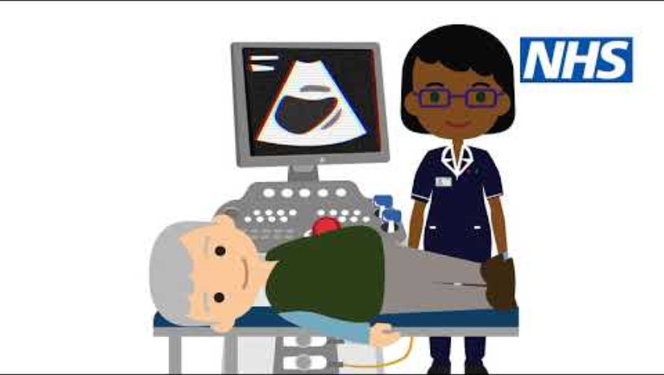
What is a PCN? This video has been produced by NHS England to explain…

Slide 5
Southport and Formby (S&F) PCN – Who are we?
Established April 2021
PCN Clinical Director is Dr Rob Caudwell
Membership includes all 15 practices in the Southport and Formby area
4 localities: North Southport, Central Southport, Ainsdale & Birkdale and Formby
High number of frail elderly patients (both in nursing homes and in their own homes)
Significant areas of deprivation (Central Southport)
We work in partnership with our GP Federation, Southport and Formby Health Ltd.

Slide 6
What are the aims of S&F PCN?
Improve resilience in General Practice
Build a stronger and more sustainable general practice service across the Primary Care Network footprint
Facilitate collaborative working between all Primary Care Network practices
Engage with local health and care providers to develop place-based care to assist in the transformation of local services to improve the health and wellbeing of the Primary Care Network population
Work with Patient Participation Groups to improve patient access, experience and quality
Reach out to strengthen and develop working relationships with non-NHS community groups
Develop signposting with Primary Care Network practices to streamline the patient journey to enhance more achievable and sustainable outcomes
Further develop digital technology as a primary resource for practices and patients
Work in collaboration with the local GP Federation to build and strengthen relationships
Notes:
Southport and Formby Primary Care Network (southportformbypcn.nhs.uk)
southportandformbyhealth.com/our-services/

Slide 7
What is the PCN trying to achieve locally?
Integrated working across Primary and Secondary care
Reduce pressure on GP practices
Workforce planning – recruitment, retention and development of staff
Population health management i.e. reducing health inequalities
Multi-disciplinary team led proactive, personalised and coordinate care for all registered patients
Estates planning – making sure practices are fit for the future and there is enough space for services to be delivered

Slide 8
Local services through the PCN structure
Enhanced Access:
7 Day GP service
Enhanced Health in Care Homes Team
Early Cancer Detection & Cancer Navigators
Pharmacy & Medicines Management Teams
Mental Health Practitioners
Social Prescribing Link Worker Service
Complex Lives Project
Health & Wellbeing Coach pilot – St Marks Medical Centre
PCN Digital Services
Working in partnership with Sefton Training Hub
Additional Roles in General Practices and with partners (ARRS)

Slide 9
What is a Patient Participation Group (PPG)?

Slide 10
Patient Participant Group (PPG) continued…
A PPG is a group of people who meet on a regular basis to discuss their General Practice (GP) and now we hope our Primary Care Network (PCN)
The group is usually made up of a mixture of patients, volunteers and practice staff
A contractual requirement for all GP practices
PPGs should be representative of the population that the practice serves
Practices should engage regularly with their PPG; this includes obtaining patient feedback
Where agreed, suggestions for improvement should be acted upon
Notes:
Contractual requirement – is just to ‘have one’ and engage but not very prescriptive – although there is lots of guidance to help.
Regarding representation – very difficult for practices to attract and get pts from across the demog involved.

Slide 11
Patient Participant Group (PPG) continued…
PPGs are open to carers of registered patients but who themselves are not registered patients
PPGs should provide a means of two-way communication between the practice and group members, giving patients the opportunity to influence decision making, support planning and delivery of practice services
PPGs should have the confidence to challenge the practice with a ‘critical friend’ ethos
PPGs should have clear ground rules, terms of reference, documents pre and post meeting and recording of information that is discussed within each meeting

Slide 12
A PPG isn’t…
A forum for complaints, specifically individual complaints – for example not being able to access an appointment the same day
A forum to seek medical advice
The only method for patients to feedback to their practice – practices will have different methods of communication with their patients

Slide 13
What can PPGs do?
Raise feedback that may help improve services offered within a GP practice or across Southport and Formby PCN
Escalate wider commissioning issues or gaps in service that can be taken to wider meetings by the GP practice/PCN
Share learning/feedback with patients and even other practices about things that have worked well
Improve communication between practice and patient/carers
Can fundraise for particular events or activities that they feel will make a difference to the practice
Invite key speakers to present relevant information
Contribute to Care Quality Commission (CQC) inspections and other developments within the GP practice
Help develop surveys, practice documentation (critical eye) and promote educational messages

Slide 14
What do we want from our PCN PPG?
An open forum to share relevant and constructive ideas and/or feedback that we can use to improve services offered to Southport and Formby residents
Patient representatives from across all practices across Southport and Formby PCN (numbers will be capped based on venue availability)
To support our GP practices across Southport and Formby PCN to engage with their patients and hear their views
Representatives from our own commissioned services and external services to deliver short presentations about what they can offer and to raise awareness of services available to Southport and Formby residents
Are there any other suggestions from those in attendance?

Slide 15
What’s important behind the scenes at practice level?

Slide 16
Do you know what goes on behind the scenes in your practice?
Patient Care
Clinical Records – managing information. Receiving letters from other providers
Appointments system; constantly reviewing and updating.
Quality / Audit work (Quality Outcomes Framework, Local Quality Contract)
Ensuring practices is well led - managing staff, rotas, appraisals, training, recruitment.
Ensuring up to date with clinical and practice level guidance / governance.
Digital systems – keeping up to date with all
Estates – managing premises, maintenance, infection control and prevention guidance
Notes:
Circa 280,000 letters received across S&F practices per year that have to be coded / read/ actioned and filed on records.

Slide 17
Behind the scenes…challenges
GP Practices and the whole of the NHS are facing significant challenges, this includes:
Increasing patient needs and having the capacity to meet this demand
Funding
Staffing
Estates
Managing expectations from patients

Slide 18
Behind the scenes…
Increasing patient needs and having the capacity to meet this demand
  Model changes
  Meeting patients’ needs
  The right clinician at the right time
  Referrals to other services
  Winter pressures
  Increasingly complex multiple needs of patients
Notes:
Practices are constantly reviewing and updating their model and making changes to ensure they can meet demand.
There are often changing requirements about how they deliver access that they have to respond to quickly.
Reality is that we’re all getting older and living longer and are likely to get long term conditions that need management. Practices have to respond to the increasing demand and think about innovative ways to solve this.
We have had the Same Day GP Service running now this year and last to provide additional appointments to enable practices to offer more appointments.
There are pressures across the system - secondary care – long waiting at acute trusts for planned care – meaning more time that pts are waiting and needing extra care to manage conditions / pain etc.

Slide 19
Behind the scenes…
Funding:
  Inflation/cost of living
  Minimum wage increase for staff and consequences from 1st April 2024
  Funding changes in contracts – these are often performance based
  Existing 5-year GP contract officially ends 31st March 2024. A new 12-month contract will start from 1st April 2024.

Slide 20
Behind the scenes…
Staffing
  Greater mix of clinical staff; not just GPs, Practice Nurses! Practices have a wide range of clinical staff to meet their patients’ needs.
  Training and development
  Recruitment challenges
Estates
  Keeping buildings fit for use and up to building standards/regulations
  Accommodating the mix of clinical staff
  Buildings are expensive to run..
Notes:
Patients can be seen by other clinicians in the practice.
Each practice has a different clinical / staff model – according to their practice demographics.
Patients don’t always need to be seen by a GP – there could be other clinicians and health care professionals who may be better placed to support patient needs. For example – practice nurses, Advanced Nurse Practitioners, Clinical Pharmacists.
PCNs are also introducing a wide range of additional roles under the ARRS scheme –
There are recruitment challenge across the whole of the NHS and general practice is no different.
Practices have to be innovative and forward thinking to plan and recruit.

Slide 21
Digital updates

Slide 22
Digital updates
All Southport & Formby practices use an online consultation tool accessed via your practice website - this can be used to submit a consultation request and dependent upon your practice, order repeat prescriptions.
This was introduced as part of the NHS Long Term Plan and practices could start offering online consultations from April 2020 and video consultations from April 2021, these are part of a term known as ‘remote consulting’
Remote consulting has both benefits and pitfalls and is dependent on good technology and skills of the patient and staff
To make remote consulting a success, practices are advised to do the following:
  Have good communication and transparent booking processes
  Seek clarity about patient ability to use remote consultations
  Offer personalised support for patients, particularly the very vulnerable
  Ensure confidentiality and continuity

Slide 23
Digital telephony
It is an NHS requirement for all practices to move to digital (cloud based) telephony from analogue solutions. This impacts all of us as broadband and house phones will need to be switched over as well
Requirement for practices to move over systems by the end of March 2024
This work is part of the Delivery plan for recovering access to primary care that was published in May 2023
This plan has two main aims:
  To help practices manage the 8am rush and reduce the number of patients struggling to contact their practice
  For patients to know on the day they contact their practice how their request will be managed
Notes:
NHS England » Modern general practice model
NHS England » Delivery plan for recovering access to primary care

Slide 24
NHS App
You can login to the NHS app to access services online via your computer, mobile phone or tablet
Via your account you can:
  Order repeat prescriptions (if your practice allows)
  Book and manage appointments
  Get health information and advice
  View your health record securely
  Access your NHS number
  Use NHS 111 online to answer questions and get instant advice or medical help near you
  Register your organ donation decision
Who can have an NHS account? You must be…
  Registered with a GP surgery in England
  Aged 13 or over

Slide 25
Feedback and suggestions for next meeting?

Slide 26
Thank you for your time!

